Slide 1
Supporting mentors with Weekly Meeting & Target Setting

Slide 2
All Associate Teachers have a Progress Journal relevant to their Course and School Based Training.
Associate Teachers will share this key document with you via their One Drive. You will be able to view previous Journals to support your understanding of their development so far.
It would be useful if they have either guest or Public Wi-Fi availability in school to download and review their Progress Journal with you.

Slide 3
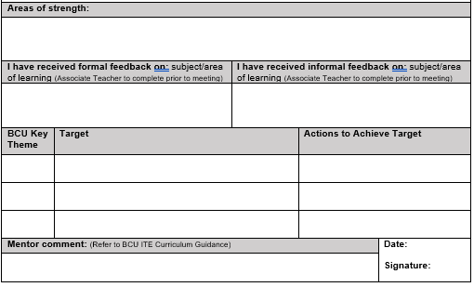
Mentors should have a weekly meeting and developmental conversation with the Associate Teacher which is recorded in the Associate Teacher’s Progress Journal. It is important that the Associate Teacher makes reference to their Subject Specific Development Journal which they will have shared with you via their One Drive folder. Targets should be considered after reviewing the relevant BCU ITE Assessment Tracker key theme, one of which should be Theme C to ensure subject knowledge remains a clear focus at each discussion.

Slide 4
Assessment Tracker – Theme C
This is a copy of Theme C. You will see that the colour coding as for our Phase 1, Phase 2 and Phase 3 of both our BAQTS and PGCE Curriculum coincides with our Primary Assessment Tracker.
Theme C, focusing on subject knowledge looks different to last year as we have combined the evidence for this section with the Subject Specific Development Journal which PGCE Associate Teachers should be sharing with you.

Slide 5
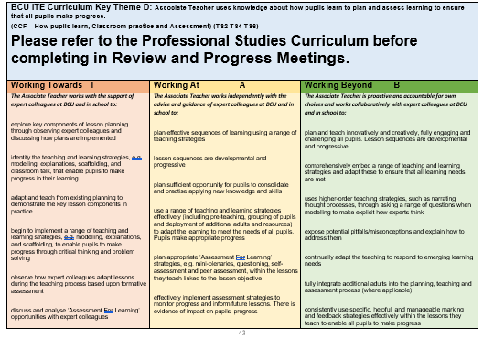
Assessment Tracker – A, B, D, E, F

