Slide 1
PGCE Primary & Early Years : School Based Training Mentor Briefing
October 2023

Slide 2
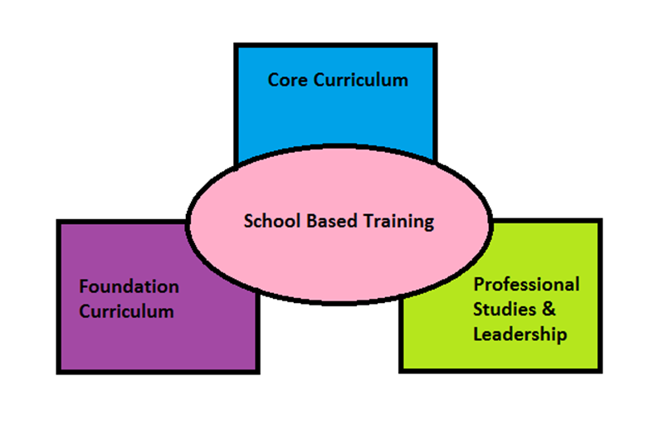
The BCU ITE Curriculum
Notes:
As we’ve said before, we have planned our BCU curriculum to ensure that all aspects of the ITT CCF are embedded either within our university based learning or school based training and that we have sequenced this in a way to make learning across the course meaningful and to enable you to revisit and build upon prior learning.
The next few slides give an example of what this might look like, using one subject from the Foundation module as an example.
To accompany spiral curriculum image: ref: Bruner - learning is a continuous process and that a student is learning to learn. Bruner believed that students learned using knowledge they already had. Using previous knowledge the student continually building on what they have already learned and expand their base of knowledge.
Building schemas

Slide 3
The BCU ITE Curriculum
BCU ITE Curriculum Key Themes
A. How trainees use critical enquiry and research informed practice to develop their understanding of effective teaching and learning.
B. How classroom practice establishes effective behaviour management through the use of high expectations and awareness of pupil wellbeing.
C. Associate Teacher knows more, remembers more and applies subject knowledge and subject specific pedagogy to impact on pupils’ progress.
D. How trainees plan and assess learning to ensure that all pupils make progress.
E. Associate Teacher implements effective adaptive teaching approaches to meet all learners’ needs, including SEND (Special Educational Needs and Disability) and EAL (English as an Additional Language learners).
F. How trainees have developed professional behaviours and contribute effectively to the wider life of the school.

Slide 4
PGCE Curriculum Document

Slide 5
Subject Specific Development Journal

Slide 6
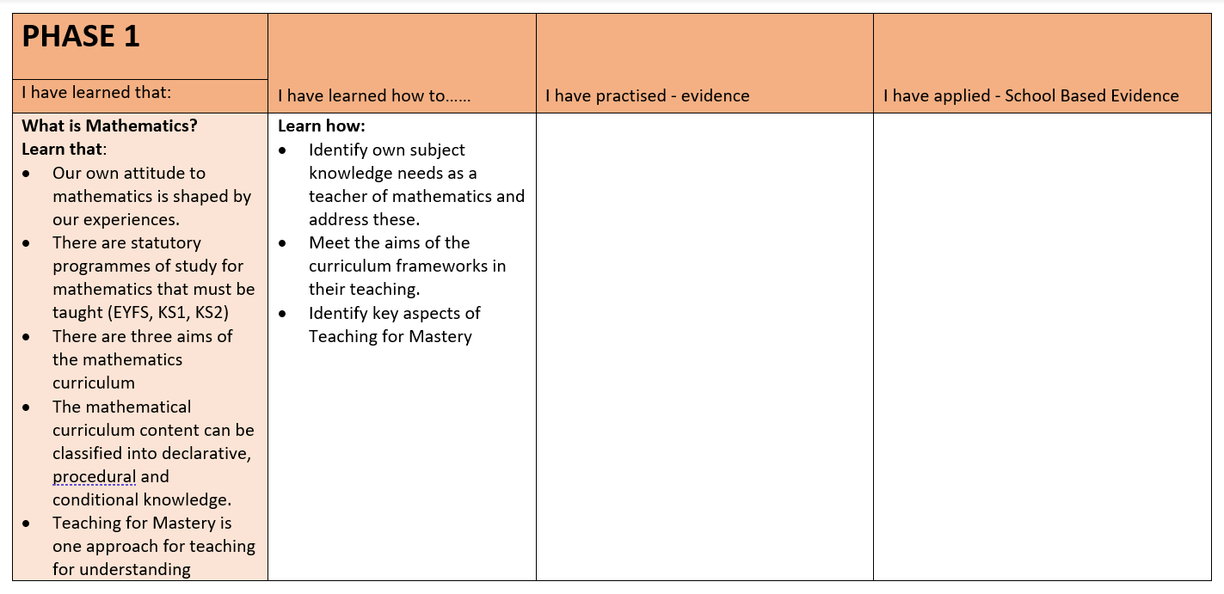

Slide 7
School Based Training 1 – FT Course
Preliminary Visits: 23rd, 24th, 25th, 26th, 27th October 6th, 7th, 8th, 9th, 10th November
UT Sign Off: 10th November
Block Placement Dates: 13th November – 22nd December
Review Meeting: WB: 27th November
Progress Meeting: WB: 18th December
UT Debrief: WB:8th January 2024
University Days: 15th November and 27th November

Slide 8
School Based Training 1 – PT Year 1 Course
Preliminary Visits: 25th, 26th October 6th, 7th, 8th, 9th, 15th, 16th, 22nd, 23rd, 29th, 30th November
UT Sign Off: 30th November
Block Placement Dates: Wednesday and Thursday from 4th December – 16th May
Review Meeting 1a: 18th March
Review Meeting 1b: WB 3rd June
Progress Meeting: WB: 1st July
UT Debrief: 8th July
University Days: 11th and 18th January

Slide 9
School Based Training 2 – PT Year 2 Course
Preliminary Visits: 25th, 26th October 6th, 7th, 8th, 9th, 15th, 16th, 22nd, 23rd, 29th, 30th November
UT Sign Off: 30th November
Block Placement Dates: Wednesday and Thursday from 4th December – 16th May
Review Meeting 2a: 18th March
Review Meeting 2b: WB 3rd June
Progress Meeting: WB: 1st July
UT Debrief: 8th July

Slide 10
Safeguarding
Prior to placement Associate Teachers will have completed Home Office Prevent training and Level 1 Safeguarding Training
Associate Teachers will receive a Safeguarding Confirmation Letter from BCU and be expected to being this into school with them
Notes:
Express importance – trainees will not go into school if this isn’t completed

Slide 12
Progress Journal
It is the Associate Teachers responsibility to keep their Progress Journal up to date.
The Associate teacher should share their Progress Journal with their UT and Mentor via their OneDrive Associate Teacher Folder
Preliminary Tasks
Associate Teacher Learning Observation
Checklist of tasks that need to be completed for sign off
BCU Assessment Tracker
Attendance register
Targets page
Weekly Meeting and Target Setting
Review/Progress Meetings
Critical Incidents

Slide 13
SBT Prelim Tasks
These are to be completed during PPSE days.
Linked directly with pre-approval checklist.
The Prelim Tasks are:
Safeguarding’ Prelim Task
Behaviour’ Prelim Task
Professional Behaviours
Professional Behaviour
Learning Environment’ Prelim Task
Foundation and Phonics Learning Observations
All prelim task must be completed prior to the UT sign off meeting.

Slide 14
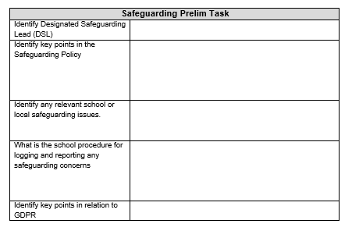

Slide 15
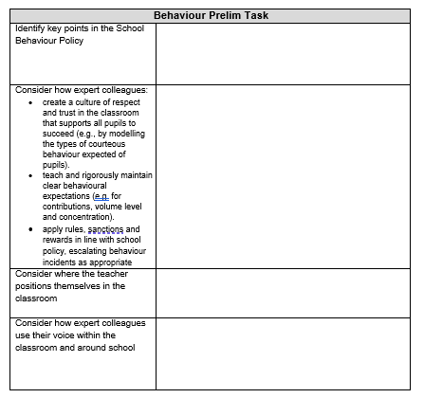

Slide 16
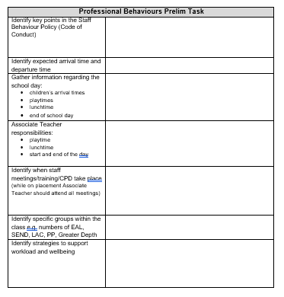

Slide 17
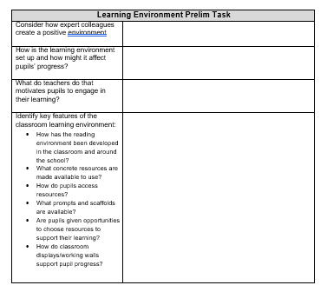

Slide 18
Associate Teacher Learning Observation
The minimum expectations in the preliminary visits of Learning Observations are:
One Core Subject
One Foundation Subject
One Phonics Session
Notes:
Refer trainees to pp3-8 of TP Booklet.

Slide 19
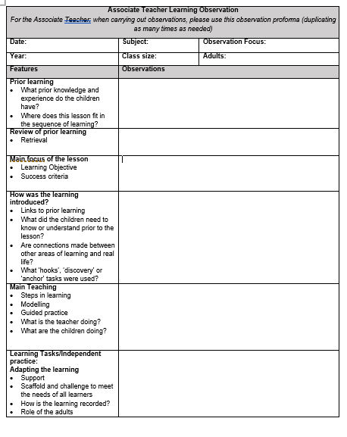
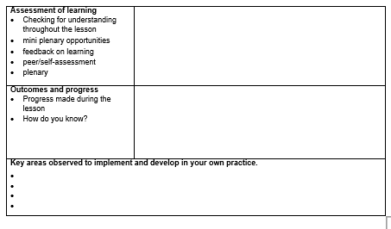

Slide 20
How to prepare for the School Based Training Block:
Develop an appropriate teaching timetable through negotiation between mentor (class teacher) and Associate Teacher.
Discuss targets and generate strategies for in-school support, this could include arranging to observe other colleagues in school.
Identify subject knowledge needs and appropriate activities/resources/ideas to support the planning process.
Identify a schedule for Weekly Meeting and Target Setting.
Identify relevant staff meetings that should be attended.
If, for any reason, you feel that the Associate Teachers is not ready to start the block experience, please contact the University Tutor.

Slide 21
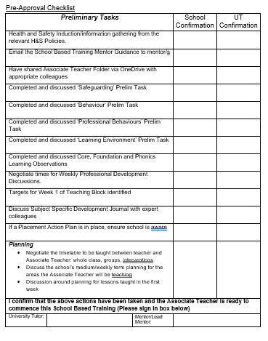
UT Sign off Meeting - Online
Associate Teacher should contact UT to arrange a time to meet via TEAMs
Targets should have been discussed
Associate Teachers will have to talk through the Pre-Approval checklist
Associate Teachers will be in school on this day but will need time to meet with their UT

Slide 22
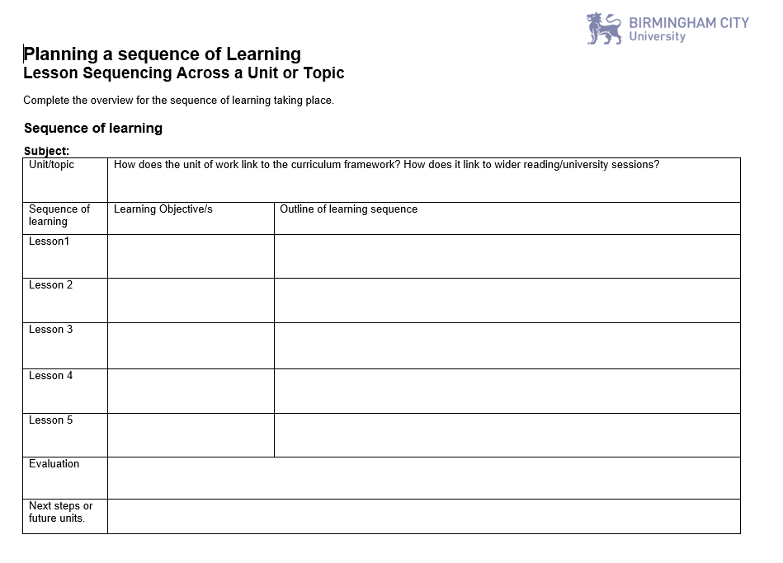

Slide 25
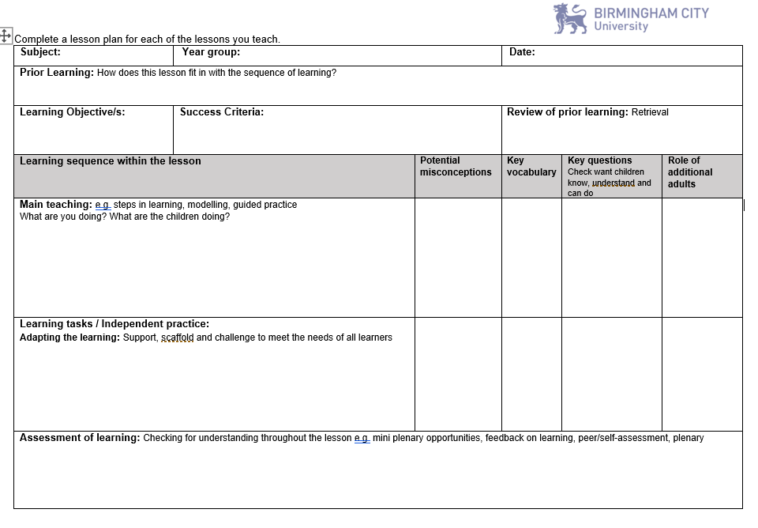

Slide 26
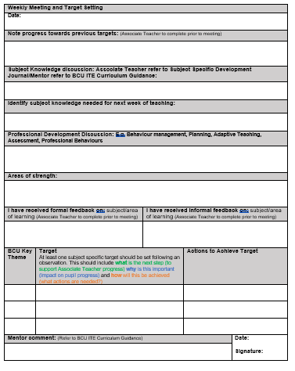
Weekly Meeting & Target Setting
These meetings provide an opportunity to identify what has been learnt and how the Associate Teachers has learnt it.
It is also an opportunity to discuss strengths and skills, knowledge and practice needed to develop.
Review targets set from the week before and set new targets
Please comment on progress towards the BCU curriculum

Slide 27
Weekly Meeting & Target Setting
Associate Teachers should be sharing their Subject Specific Development Journal at the Weekly Meetings. They should be talking to you about how their subject knowledge has developed with links to learning from university and how they have applied it in the classroom.

Slide 28
Weekly Meeting & Target Setting
Comments should be made relating to Professional Studies such as Behaviour Management, relationships with parents/carers, the wider roles and responsibilities of a teacher, planning and assessment.

Slide 29
Target Setting

Slide 30
Focus on Target Setting
Target Setting: At least one subject specific target should be set following an observation. This should include what is the next step (to support Associate Teacher progress) why is this important (impact on pupil progress) and how will this be achieved (what actions are needed?)
PE EXAMPLE:
To scaffold the learning to enable all children to demonstrate the skill of jumping from 2 feet to 2 feet using the STEP model.
MATHS EXAMPLE
To use concrete resources for column addition to ensure secure procedural knowledge by modelling methods using concrete resources and provide opportunities for pupil to use them alongside the abstract.
HISTORY EXAMPLE
To embed effective use of timelines in your history teaching in order to develop and secure children’s chronological knowledge by revisiting university taught sessions for specific examples and including them within your history planning and teaching.

Slide 31
Teaching on placement FT & PT Yr1
From the start of the block placement Associate Teachers should be teaching one lesson per day
By the end of the placement, Associate Teachers will be teaching a 50% timetable
Teaching should be predominately whole class teaching, but can include elements of team teaching, teaching of small groups and interventions.

Slide 32
Teaching on placement PT Yr2 /SBT2
Start at a 50% teaching timetable moving to a 60% teaching commitment.
By the end of the placement, in negotiation with the class teacher, trainees should each teach an 80% timetable for at least two weeks.
Teaching can include whole class teaching, team teaching, teaching of small groups and interventions.

Slide 33
Lesson observations
Please use the BCU Lesson Observation Feedback Form
Subject Feedback Prompts are there to support with subject specific observation feedback – these can all be accessed on the Primary Partnership Website
First observation in Week 1 of School Based Training block
One observation per week (Part Time trainees one every 4/5 days)
One joint observation per School Based Training UT & a school mentor

Slide 34
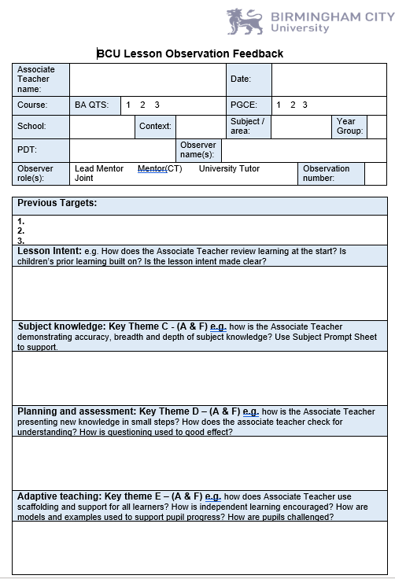
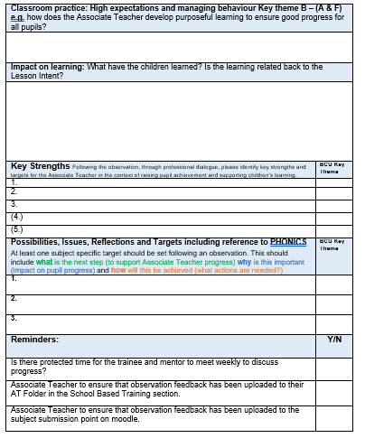

Slide 35
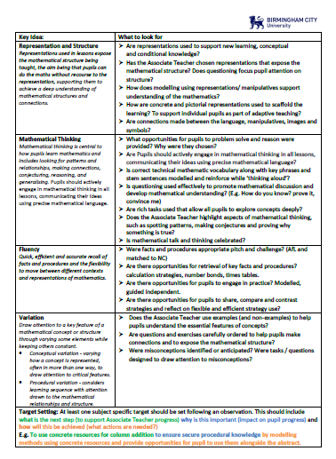
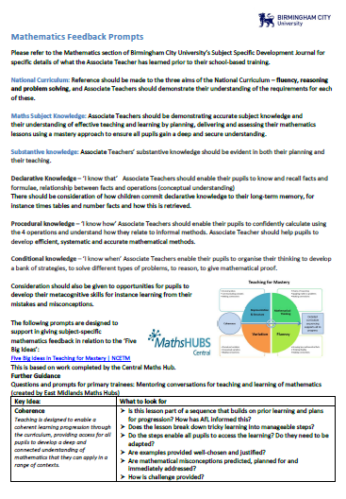
Subject Specific Feedback Prompts

Slide 36
Critical Incident - Definition
Critical incidents are learning situations that lead to significant learning and personal growth.
A critical incident does not need to be a serious or dangerous event; rather “critical” is to be interpreted as relevant or important that would require more in-depth reflections.

Slide 37
Critical Incident
At each Review/Progress Meeting Associate Teachers will present to whoever is completing the meeting a Critical Incident that demonstrates progress towards the BCU Curriculum Key Themes and ultimately the Teachers Standards.
The Critical Incident must show that the Associate Teacher can present and discuss with expert colleagues:
INTENTION
IMPLEMENTATION
IMPACT

Slide 38
Critical Incident
Prior to each Review/Progress Meeting the Associate Teacher will need to prepare a Critical Incident.
They can use evidence to support their Critical Incident.
5 pieces maximum to demonstrate progress towards the BCU Curriculum Key Themes.
Critical Incident gives an opportunity for the Associate Teacher show how they are progressing and developing.

Slide 39
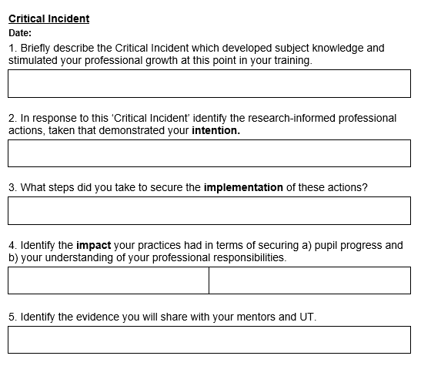

Slide 40
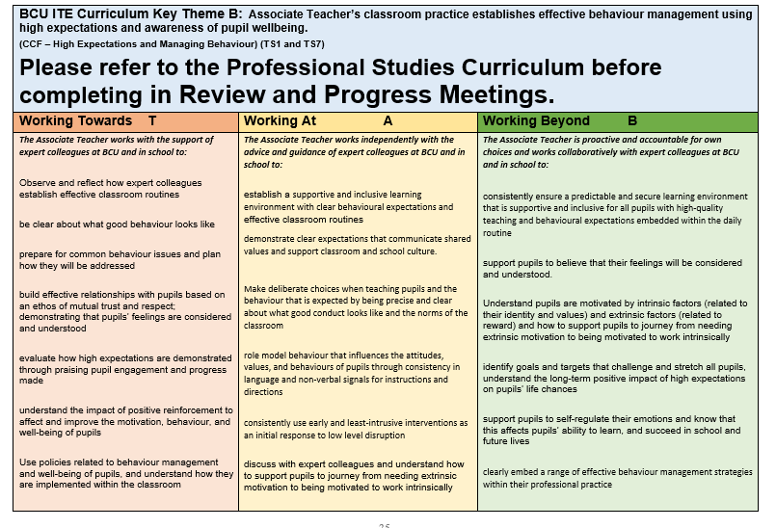
The BCU Assessment Tracker

Slide 42
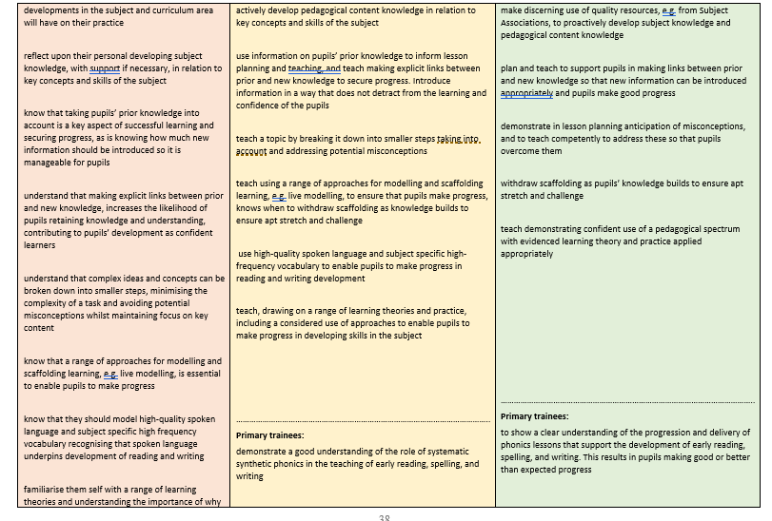

Slide 43
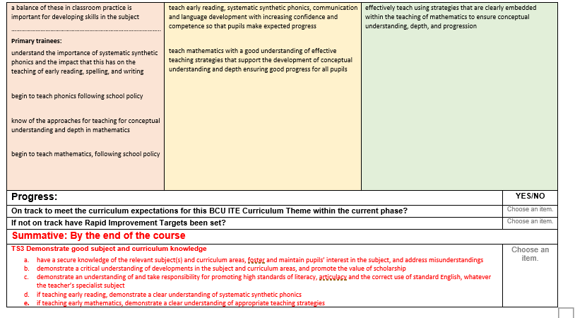

Slide 44
Review Meeting 1 and Progress Meeting 1
Review Meeting 1: WB: 27th November 2023
UT (either in-person or online), class teacher/mentor, and Associate Teacher. Observation feedback discussion. Sharing Critical Incident. Progress against BCU Key Themes.
Progress Meeting 1: WB: 18th December 2023
UT (either in-person or online), class teacher/mentor, and Associate Teacher. Observation feedback discussion. Sharing Critical Incident. Progress against BCU Key Themes.
Notes:
Reinforce the importance of trainees preparing fully for their weekly professional development discussions by completing the weekly reflection grid.

Slide 45
Assessment of School Based Training
Review Meeting 1​ - Full Time
Review Meeting 1 (SBT1) Associate Teachers who are on track to be awarded QTS at the end of the course will be demonstrating their competence in some of the BCU Curriculum Themes at Working Towards level.
Associate Teacher requiring improvement is not able to demonstrate their competence in some elements of the BCU Curriculum Themes at Working Towards level and/or not fully engaged or responding to advice and feedback. The Associate Teacher will be subject to the Rapid Improvement process and targets and strategies for improvement will be identified and a Rapid Improvement Targets (RIT) form will be completed.

Slide 46
Assessment of School Based Training
Progress Meeting 1​ - Full Time
Progress Meeting 1 (SBT 1) – Associate teachers who are on track to be awarded QTS at the end of the course will be demonstrating their competence in 75% of each BCU Curriculum Theme at the Working Towards level.
Associate Teachers requiring improvement are demonstrating their competence in less than 75% of each of the BCU Curriculum Themes at Working Towards level and/or not fully engaged or responding to advice and feedback. The Associate Teacher will be subject to the Rapid Improvement process and targets and strategies for improvement will be identified and a Rapid Improvement Targets (RIT) form will be completed to be shared with the next placement school.
Associate Teachers not demonstrating their competence in at least 50% of elements in each of the BCU Curriculum Themes at Working Towards level and/or not fully engaged or responding to advice and feedback will have failed SBT1.

Slide 47
Review Meeting 1a/1b and Progress Meeting 1 Part Time Year 1
Review Meeting 1a: 18/19 March
UT (either in person or online), mentor (class teacher)Lead mentor, and Associate Teacher. Sharing Critical Incident. Progress against BCU Key Themes.
Review Meeting 1b: WB 3rd June
UT (either in person or online), mentor (class teacher)Lead mentor, and Associate Teacher. Sharing Critical Incident. Progress against BCU Key Themes.
Progress Meeting 1: WB: 1st July
UT (either in person or online), mentor (class teacher)Lead mentor, and Associate Teacher. Sharing Critical Incident. Progress against BCU Key Themes. Targets reviewed. Record strengths and areas for development.
Notes:
Reinforce the importance of trainees preparing fully for their weekly professional development discussions by completing the weekly reflection grid.

Slide 48
Assessment of School Based Training
Review Meeting 1a​ - Part Time Year 1
Review Meeting 1a (SBT1) Associate Teachers who are on track to be awarded QTS at the end of the course will be demonstrating their competence in some of the BCU Curriculum Themes at Working Towards level.
Associate Teacher requiring improvement is not able to demonstrate their competence in some elements of the BCU Curriculum Themes at Working Towards level and/or not fully engaged or responding to advice and feedback. The Associate Teacher will be subject to the Rapid Improvement process and targets and strategies for improvement will be identified and a Rapid Improvement Targets (RIT) form will be completed.

Slide 49
Assessment of School Based Training
Review Meeting 1b - Part Time Year 1
Review Meeting 1b (SBT 1) – Associate teachers who are on track to be awarded QTS at the end of the course will be demonstrating their competence in 75% of each BCU Curriculum Theme at the Working Towards level.
Associate Teachers requiring improvement are demonstrating their competence in less than 75% of each of the BCU Curriculum Themes at Working Towards level and/or not fully engaged or responding to advice and feedback. The Associate Teacher will be subject to the Rapid Improvement process and targets and strategies for improvement will be identified and a Rapid Improvement Targets (RIT) form will be completed to be shared with the next placement school.

Slide 50
Assessment of School Based Training
Progress Meeting 1​ - Part Time Year 1
Progress Meeting 1 (SBT1) Associate teachers who are on track to be awarded QTS at the end of the course will be demonstrating their competence in 75% of each BCU Curriculum Theme at the Working Towards level.
Associate Teachers requiring improvement are demonstrating their competence in less than 75% of each of the BCU Curriculum Themes at Working Towards level and/or not fully engaged or responding to advice and feedback. The Associate Teacher will be subject to the Rapid Improvement process and targets and strategies for improvement will be identified and a Rapid Improvement Targets (RIT) form will be completed.
Associate Teachers not demonstrating their competence in at least 50% of elements in each of the BCU Curriculum Themes at Working Towards level and/or not fully engaged or responding to advice and feedback will have failed SBT1.

Slide 51
Review Meeting 1a/1b and Progress Meeting 1 Part Time Year 2
Review Meeting 2a: 18/19 March
UT (either in person or online), mentor (class teacher)Lead mentor, and Associate Teacher. Sharing Critical Incident. Progress against BCU Key Themes.
Review Meeting 2b: WB 3rd June
UT (either in person or online), mentor (class teacher)Lead mentor, and Associate Teacher. Sharing Critical Incident. Progress against BCU Key Themes.
Progress Meeting 2: WB: 1st July
UT (either in person or online), mentor (class teacher)Lead mentor, and Associate Teacher. Sharing Critical Incident. Progress against BCU Key Themes. Targets reviewed. Record strengths and areas for development.
Notes:
Reinforce the importance of trainees preparing fully for their weekly professional development discussions by completing the weekly reflection grid.

Slide 52
Assessment of School Based Training
Review Meeting 2a​ - Part Time Year 2
Review Meeting 2a (SBT 2) – Associate teachers who are on track to be awarded QTS at the end of the course will be demonstrating their competence in all elements all of the BCU Curriculum Themes at the Working Towards level and elements in the Working At Level.
Associate Teachers requiring improvement are demonstrating their competence in all elements of all of the BCU Curriculum Themes at Working Towards level and/or not fully engaged or responding to advice and feedback. The Associate Teacher will be subject to the Rapid Improvement process and targets and strategies for improvement will be identified and a Rapid Improvement Targets (RIT) form will be completed to be shared with the next placement school.

Slide 53
Assessment of School Based Training
Review Meeting 2b - Part Time Year 2
Review Meeting 2b (SBT 2) Associate Teachers who are on track to be awarded QTS at the end of the course will be demonstrating their competence in 75% of each of the BCU Curriculum Themes at the Working At Level.
If the Associate Teacher is not able demonstrate competence in in all of the BCU Curriculum Themes at the Working Towards Level and 50% in the Working At Level their progress is judged as requiring improvement. The Associate Teacher will become subject to the Rapid Improvement process and targets and strategies for improvement will be identified and a Rapid Improvement Targets (RIT) form will be completed.

Slide 54
Assessment of School Based Training
Progress Meeting 2​ - Part Time Year 2
Progress Meeting 2 (SBT 2) –. Associate Teachers who are on track to be awarded QTS at the end of the course will be demonstrating their competence in all elements of all of the BCU Curriculum Themes at the Working At Level.
Associate Teachers demonstrating their competence at the Working Beyond level can be deemed to have made very good progress in readiness for their ECT year.
Associate Teachers not demonstrating their competence in all the BCU Curriculum Themes at Working At level and/or not fully engaged or responding to advice and feedback will have failed SBT2.

Slide 55
Rapid Improvement Target
Issued if Associate Teachers:
Are not making expected progress;
Are not demonstrating high standards of personal and professional conduct.
All RIT’s should be emailed to: PrimaryandEarlyYearsPGCECourseTeam@bcu.ac.uk
Details of the process will be explained if necessary.
Notes:
Having several RIT’s for the same areas with no development can result in a failed placement

Slide 56
Termination of Placements
Where a termination of placement occurs the circumstances are considered by the Placement Review Panel and recommendations made regarding further placements and actions to be undertaken.
Resitting a School Based Training placement, as a consequence of a failed first attempt, will incur a cost to the trainee of £1125. The trainee may be eligible for funding, but this should be discussed with Student Finance England direct to confirm details and determine whether there is eligibility.
There may be exceptional circumstances where this fee can be waived; however the tutor will confirm this in writing to the trainee where such a circumstance will apply.

Slide 57
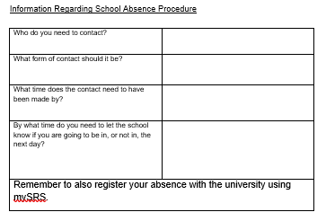
Attendance and Absence Procedure
Associate Teachers should follow the School Absence Procedure.
This is one of the first tasks they should do on their prelim visits.

Slide 58
Mentor Support - Access to all our University documentation, mentor CPD and partnership information.
https://www.bcu.ac.uk/education-and-social-work/partnerships-and-collaborations/primary-early-years-partnerships

Slide 59
Useful Contacts
PGCE Course Team:
PrimaryandEarlyYearsPGCECourseTeam@bcu.ac.uk
Education Partnerships Team:
Martin Drury
martin.drury@bcu.ac.uk (PGCE)
Primary Partnership Lead:
Anne Whitacre
anne.whitacre@bcu.ac.uk

Slide 60
And finally…….
Any Questions?

